Slide 1

Computer Networks

Slide 2

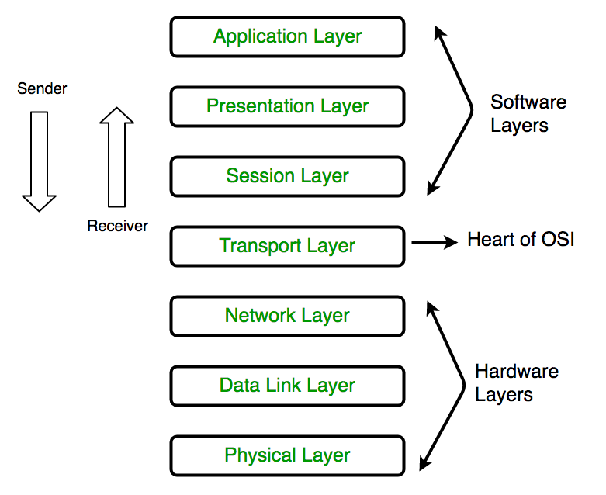
Unit II: Network
Layer

Slide 3
Contents
Services
Switching Techniques: Datagram Approach, Virtual-Circuit Approach
Internet Protocol: Ipv4 & Ipv6
Classful Addressing
Classless Addressing
CIDR
Subnetting, NAT, ICMP
Routing Algorithms: Distance-Vector (DV) Routing, Link State (LS) Routing
Routing in Internet: RIP, OSPF, BGP

Slide 4
Functions of Network Layer
The Network Layer is the third layer of the OSI model.
It handles the service requests from the transport layer and further forwards the service request to the data link layer.
The network layer translates the logical addresses into physical addresses
It determines the route from the source to the destination and also manages the traffic problems such as switching, routing and controls the congestion of data packets.
The main role of the network layer is to move the packets from sending host to the receiving host.

Slide 5
Functions of Network Layer
Guaranteed delivery: This layer provides the service which guarantees that the packet will arrive at its destination.
Guaranteed delivery with bounded delay: This service guarantees that the packet will be delivered within a specified host-to-host delay bound.
In-Order packets: This service ensures that the packet arrives at the destination in the order in which they are sent.
Guaranteed max jitter: This service ensures that the amount of time taken between two successive transmissions at the sender is equal to the time between their receipt at the destination.
Security services: The network layer provides security by using a session key between the source and destination host. The network layer in the source host encrypts the payloads of datagrams being sent to the destination host. The network layer in the destination host would then decrypt the payload. In such a way, the network layer maintains the data integrity and source authentication services.

Slide 6
Network Layer Services
Packetizing: The process of encapsulating the data received from the upper layers of the network (also called payload) in a network layer packet at the source and decapsulating the payload from the network layer packet at the destination is known as packetizing.
Routing: When a packet reaches the router's input link, the router will move the packets to the router's output link. For example, a packet from S1 to R1 must be forwarded to the next router on the path to S2.
Logical Addressing: The data link layer implements the physical addressing and network layer implements the logical addressing. Logical addressing is also used to distinguish between source and destination system. The network layer adds a header to the packet which includes the logical addresses of both the sender and the receiver.
Internetworking: This is the main role of the network layer that it provides the logical connection between different types of networks.
Fragmentation: The fragmentation is a process of breaking the packets into the smallest individual data units that travel through different networks.

Slide 7
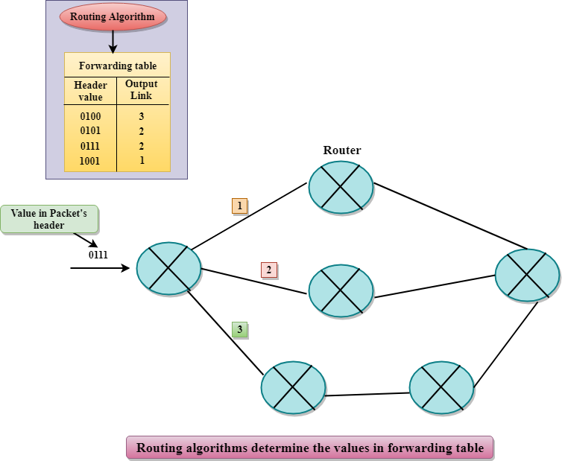
Network Layer Services (Cntd.)
Forwarding & Routing
A router forwards a packet by examining a packet's header field and then using the header field value to index into the forwarding table.
The value stored in the forwarding table corresponding to the header field value indicates the router's outgoing interface link to which the packet is to be forwarded.

Slide 8
Network Layer Design Issues
Routing is the process of moving data from one device to another device.
The network layer specifies some strategies which find out the best possible route. This process is referred to as routing.
Forwarding is simply defined as the action applied by each router when a packet arrives at one of its interfaces.
The process of routing involves packet forwarding from an entry interface out to an exit interface.

Slide 9
Network Layer Design Issues (Cntd.)
Store and Forward packet switching:
The host sends the packet to the nearest router.
This packet is stored there until it has fully arrived once the link is fully processed by verifying the checksum
then it is forwarded to the next router till it reaches the destination.
This mechanism is called “Store and Forward packet switching.”

Slide 10
Network Layer Design Issues (Cntd.)
2. Services provided to Transport Layer:
Through the network-transport layer interface, the network layer transfers it’s services to the transport layer. But before providing these services to the transport layer following goals must be kept in mind
Offering services must not depend on router technology.
The transport layer needs to be protected from the type, number and topology of the available router.
The network addresses for the transport layer should use uniform numbering pattern also at LAN and WAN connections.

Slide 11
Network Layer Design Issues (Cntd.)
Based on the connections there are 2 types of services provided :
Connectionless – The routing and insertion of packets into subnet is done individually. No added setup is required.
Connection-Oriented – Subnet must offer reliable service and all the packets must be transmitted over a single route.
In large networks, there may be more than one paths for transmitting data from sender to receiver.
There are two popular switching techniques – circuit switching and packet switching.

Slide 12
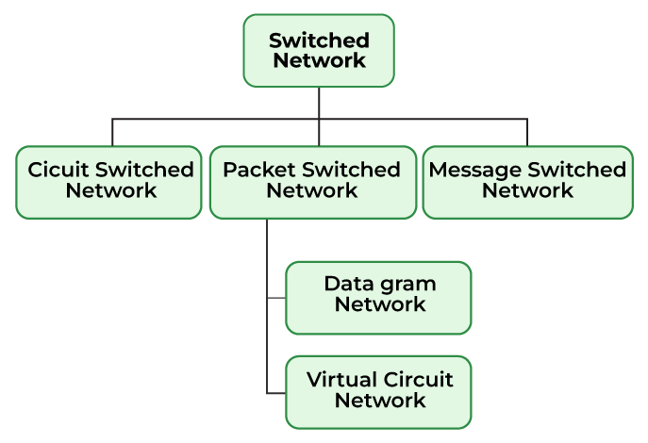
Switching Techniques

Slide 13
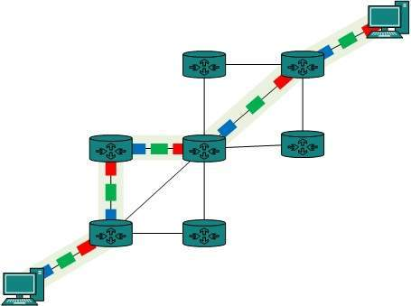
Circuit Switching Techniques
When a dedicated path is established for data transmission between sender and receiver, it is called circuit switching.
There 'is a need of pre-specified route from which data will travels and no other data is permitted.
Circuits can be permanent or temporary.
Three phases
Establish a circuit
Transfer the data
Disconnect the circuit

Slide 14
Circuit Switching Techniques
Advantages of Circuit Switching
Once path is set up, the only delay is in data transmission speed
No problem of congestion or garbled message
Disadvantages of Circuit Switching
Long set up time is required
A request token must travel to the receiver and then acknowledged before any transmission can happen
Line may be held up for a long time

Slide 15
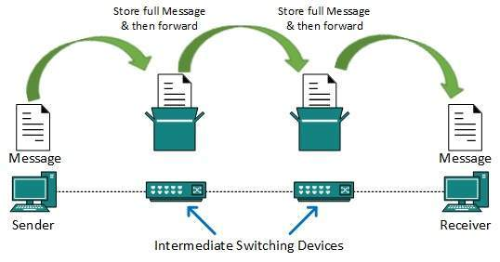
Message Switching Techniques
In message switching, the whole message is treated as a data unit and is switching / transferred in its entirety.
A switch first receives the whole message and buffers it until there are resources available to transfer it to the next hop.
There is no establishment of a dedicated path between the sender and receiver.
If the next hop is not having enough resource to accommodate large size message, the message is stored and switch waits.

Slide 16
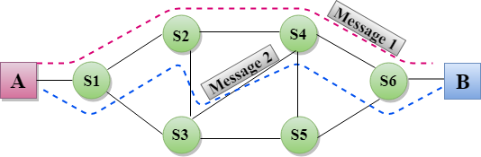
Message Switching Techniques
The destination address is appended to the message.
It is a dynamic routing as the message is routed through the intermediate nodes based on the information available in the message.
Each and every node stores the entire message and then forward it to the next node. This type of network is known as store and forward network.

Slide 17
Message Switching Techniques
Advantages of Message switching:
Data channels are shared among the communicating devices that improve the efficiency of using available bandwidth.
Traffic congestion can be reduced because the message is temporarily stored in the nodes.
Message priority can be used to manage the network.
The size of the message which is sent over the network can be varied. Therefore, it supports the data of unlimited size.
Disadvantages of Message switching:
Every switch in transit path needs enough storage to accommodate entire message.
Because of store-and-forward technique and waits included until resources are available, message switching is very slow.
Message switching was not a solution for streaming media and real-time applications.

Slide 18
Packet Switching Techniques
In packet switching technique the message is sent in one go, but it is divided into smaller pieces, known as packets, and they are sent individually.
Packets are given a unique number to identify their order at the receiving end.
Every packet contains some information in its headers such as source address, destination address and sequence number.
Packets travel across the network, taking the shortest path as possible.
All the packets are reassembled at the receiving end in correct order.
If any packet is missing or corrupted, then the message will be sent to resend the message.
If the correct order of the packets is reached, then the acknowledgment message will be sent.

Slide 19
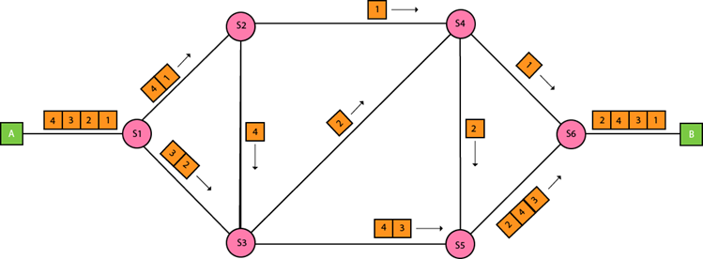
Packet Switching Techniques
There are two approaches to Packet Switching:
Datagram Packet switching
Virtual Circuit Switching

Slide 20
Packet Switching
Advantages of Packet Switching
Delay in delivery of packets is less, since packets are sent as soon as they are available.
Switching devices don’t require massive storage, since they don’t have to store the entire messages before forwarding them to the next node.
Data delivery can continue even if some parts of the network faces link failure. Packets can be routed via other paths.
It allows simultaneous usage of the same channel by multiple users.
It ensures better bandwidth usage as a number of packets from multiple sources can be transferred via the same link.

Slide 21
Packet Switching
Disadvantages of Packet Switching
They are unsuitable for applications that cannot afford delays in communication like high quality voice calls.
Packet switching high installation costs.
They require complex protocols for delivery.
Network problems may introduce errors in packets, delay in delivery of packets or loss of packets. If not properly handled, this may lead to loss of critical information.

Slide 22
Datagram Packet Switching
It is a packet switching technology in which packet is known as a datagram, is considered as an independent entity.
Datagram Packet Switching is also known as connectionless switching.
Each packet contains the information about the destination and switch uses this information to forward the packet to the correct destination.
The packets are reassembled at the receiving end in correct order.
In Datagram Packet Switching technique, the path is not fixed.
Intermediate nodes take the routing decisions to forward the packets.

Slide 23
Virtual Circuit - Packet Switching
Virtual Circuit Switching is also known as connection-oriented switching.
In the case of Virtual circuit switching, a preplanned route is established before the messages are sent.
Call request and call accept packets are used to establish the connection between sender and receiver.
In this case, the path is fixed for the duration of a logical connection.

Slide 24
Comparison of Virtual-Circuit and Datagram
Criteria | Virtual Circuit Networks | Datagram Networks
Connection Establishment | Prior to data transmission, a connection is established between sender and receiver. | No connection setup is required.
Routing | Routing decisions are made once during connection setup and remain fixed throughout the duration of the connection. | Routing decisions are made independently for each packet and can vary based on network conditions.
Flow Control | Uses explicit flow control, where the sender adjusts its rate of transmission based on feedback from the receiver. | Uses implicit flow control, where the sender assumes a certain level of available bandwidth and sends packets accordingly.

Slide 25
Comparison of Virtual-Circuit and Datagram
Criteria | Virtual Circuit Networks | Datagram Networks
Congestion Control | Uses end-to-end congestion control, where the sender adjusts its rate of transmission based on feedback from the network. | Uses network-assisted congestion control, where routers monitor network conditions and may drop packets or send congestion signals to the sender.
Error Control | Provides reliable delivery of packets by detecting and retransmitting lost or corrupted packets. | Provides unreliable delivery of packets and does not guarantee delivery or correctness.
Overhead | Requires less overhead per packet because connection setup and state maintenance are done only once. | Requires more overhead per packet because each packet contains information about its destination address and other routing information.

Slide 26
Network Layer: Logical Addressing
These are 32 bits in size
Logical address is called as IP address.
These are global addresses
The Internet addresses are 32 bits in length, called as IPv4 (IP version 4) or IP address
2^32 addresses can be generated
IPv6 (IP version 6) as futuristic/new generation addresses 128 bits in size.
2^128 addresses can be generated which can accommodate future need and can address the issue of depletion of IP addresses.

Slide 27
IPv4 Addresses
These are unique and Universal addresses
Each address defines one and only one connection to the internet.
Two devices can never have same IP address at the same time.
An address can be assigned to a device for some time, then taken away and can be assigned to some other device.

Slide 28
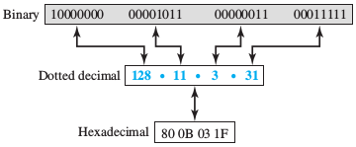
IPv4 Addresses
Address space is 2^32
Notations:
Binary notation
Decimal dotted notations

Slide 29
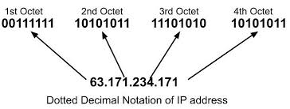
Binary and dotted decimal notations

Slide 30

IPv4: Header
IPv4 short for Internet Protocol Version 4 is the fourth version of the Internet Protocol (IP).
IP is responsible to deliver data packets from the source host to the destination host.
This delivery is solely based on the IP Addresses in the packet headers.
IPv4 is the first major version of IP.
IPv4 is a connectionless protocol for use on packet-switched networks.

Slide 31
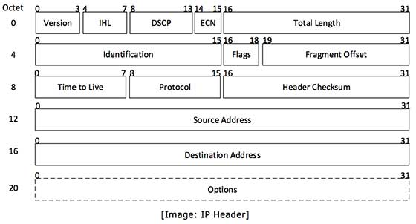
IPv4: Header
https://www.gatevidyalay.com/ipv4-ipv4-header-ipv4-header-format/

Slide 32
IPv4 Addresses
Version-
Version is a 4 bit field that indicates the IP version used.
The most popularly used IP versions are version-4 (IPv4) and version-6 (IPv6).
Only IPv4 uses the above header.
So, this field always contains the decimal value 4.
Type Of Service-
Type of service is a 8 bit field that is used for Quality of Service (QoS).
The datagram is marked for giving a certain treatment using this field.
Total Length-
Total length is a 16 bit field = total length of the datagram (in bytes).
Total length = Header length + Payload length
Minimum total length of datagram = 20 bytes (20 bytes header + 0 bytes data)
Maximum total length of datagram = 65535 bytes

Slide 33
IPv4 Addresses
Header Length-
Header length is a 4 bit field.
The length of IP header always lies in the range- [20 bytes , 60 bytes]
The initial 5 rows of the IP header are always used.
So, minimum length of IP header = 5 x 4 bytes = 20 bytes.
The size of Options field can go up to 40 bytes.
So, maximum length of IP header = 20 bytes + 40 bytes = 60 bytes.
to represent the header length, a scaling factor of 4 is used.
Header length = Header length field value x 4 bytes
If header length field = 5 (0101), then Header length = 5 x 4 = 20 bytes
If header length field =10 (1010),then Header length = 10 x 4 = 40 bytes
If header length field =15 (1111),then Header length = 15 x 4 = 60 bytes

Slide 34
IPv4 Addresses
Identification-
Identification is a 16 bit field.
It is used for the identification of the fragments of an original IP datagram.
Each fragmented datagram is assigned the same identification number.
This number is useful during the re assembly of fragmented datagrams.
It helps to identify to which IP datagram, the fragmented datagram belongs to.
DF Bit-
DF bit stands for Do Not Fragment bit.
Its value may be 0 or 1.
When DF bit is set to 0, It grants the permission to the intermediate devices to fragment the datagram if required.
When DF bit is set to 1, It indicates the intermediate devices not to fragment the IP datagram at any cost.

Slide 35
IPv4 Addresses
MF Bit-
MF bit stands for More Fragments bit.
Its value may be 0 or 1
When MF bit is set to 0, It indicates to the receiver that the current datagram is either the last fragment in the set or that it is the only fragment.
When MF bit is set to 1, It indicates to the receiver that the current datagram is a fragment of some larger datagram and more fragments are following.
MF bit is set to 1 on all the fragments except the last one.

Slide 36
IPv4 Addresses
Fragment Offset-
Fragment Offset is a 13 bit field.
It indicates the position of a fragmented datagram in the original unfragmented IP datagram.
The first fragmented datagram has a fragment offset of zero.
Fragment offset for a given fragmented datagram
= Number of data bytes ahead of it in the original unfragmented datagram
Fragment offset field value = Fragment Offset / 8

Slide 37
IPv4 Addresses
Time To Live-
Time to live (TTL) is a 8 bit field.
It indicates the maximum number of hops a datagram can take to reach the destination.
The main purpose of TTL is to prevent the IP datagrams from looping around forever in a routing loop.
The value of TTL is decremented by 1 when-
Datagram takes a hop to any intermediate device having network layer.
Datagram takes a hop to the destination.
If the value of TTL becomes zero before reaching the destination, then datagram is discarded.

Slide 38
IPv4 Addresses
Protocol-
Protocol is a 8 bit field.
It tells the network layer at the destination host to which protocol the IP datagram belongs to.
In other words, it tells the next level protocol to the network layer at the destination side.
Protocol number of ICMP is 1, IGMP is 2, TCP is 6 and UDP is 17.

Slide 39
IPv4 Addresses
Header Checksum-
Header checksum is a 16 bit field.
It contains the checksum value of the entire header.
The checksum value is used for error checking of the header.
At each hop,
The header checksum is compared with the value contained in this field.
If header checksum is found to be mismatched, then the datagram is discarded.
Router updates the checksum field whenever it modifies the datagram header.

Slide 40
IPv4 Addresses
Source IP Address-
Source IP Address is a 32 bit field.
It contains the logical address of the sender of the datagram.
Destination IP Address-
Destination IP Address is a 32 bit field.
It contains the logical address of the receiver of the datagram.
Options-
Options is a field whose size vary from 0 bytes to 40 bytes.
This field is used for several purposes such as-
Record route
Source routing
Padding

Slide 41
IPv4 Addresses
Classful addressing
Right from inception, used the concept of classes.
This architecture is called as classful addressing
The address space is divided in classes A,B,C,D,E
This is becoming obsolete, but necessary to know to understand the rational behind classless addressing.
Classless addressing

Slide 42
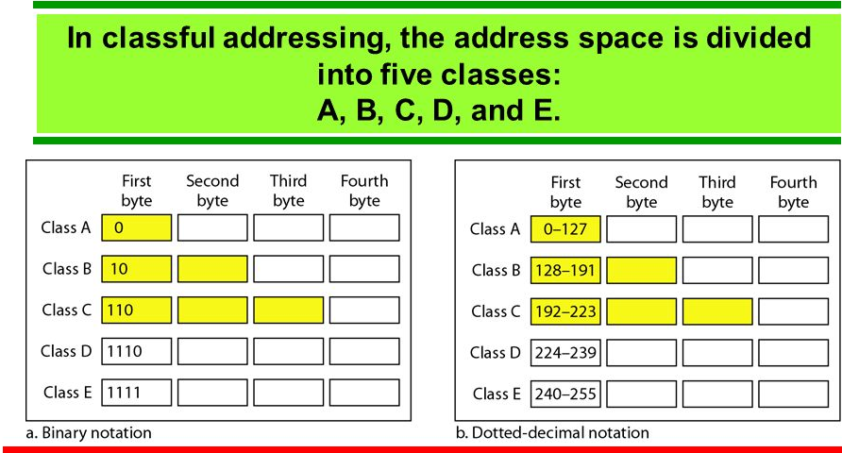

Slide 43
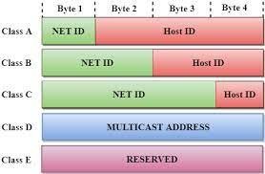
Host ID and Net ID (Does not apply for class D and E)

Slide 44
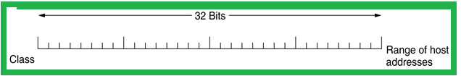
Classful and Special Addressing
Before 1993, IP addresses were divided into the five categories
128 networks with 16 million hosts
16,384 networks with up to 65,536 hosts
2 million networks and 256 hosts

Slide 45
Special IP Addresses

Slide 46
Special IP Addresses: Local Host
0.0.0.0/32
The number of addresses in this block is equal to 2³²⁻³² = 2⁰ = 1
this block has only one address with all the 32 bits as zero.
This address is the first address in the IPv4 address space.
Any host having this IP address means the host is not connected to the TC/IP network.
When the host wants to get connected to the internet, it sends a request packet to the bootstrap server which is also called a DHCP server.

Slide 47
Special IP Addresses: Broadcast Address
The block 225.225.225.225/32 is also a special block in IPv4 address space. Here, all the 32 bits of IPv4 address is ‘1‘.
The length of the prefix here is 32.
The number of addresses in this special block can be calculated as 2³²⁻³² = 2⁰ = 1.
This is the last address in IPv4 address space. This address is also called Limited Broadcast Address
If a host wants to send the message to every other host in the current network ( i.e. broadcast) then the host uses this address as the destination address in the IPv4 packet and sends it on the network.
The packets are broadcasted in local network only

Slide 48
Special IP Addresses: Loopback Addresses
The special block 127.0.0.0/8 has addresses which are used as loopback addresses.
The prefix length here is 8 so, the number of addresses can be calculated as 232-8 = 224 = 1,67,77,216.
This special block has 1,67,77,216 addresses.
If we consider this address in classful addressing, then this block is the last block of class A.
The loopback address can only be the destination address of a packet.
The packet with loopback address never leaves the machine from which it is sent, it just returns back to the source.

Slide 49
Special IP Addresses: Multicast Addresses
The block 224.0.0.0/4 has the multicast address.
The length of the prefix is 4.
The number of addresses used for multicast communication is 2³²⁻⁴ = 2²⁸ = 26,84,35,456.
The multicast address is assigned to the group of the host instead of one single host.
The packet sent to the multicast address is delivered to all the host of that group.

Slide 50
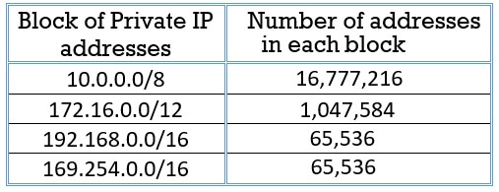
Special IP Addresses: Private Addresses
As the name suggests the private IP addresses are never used globally.
The packet with a private IP address is not routed on the internet.
The private IP addresses are configured by the administrator of the network. Devices on the same network use private IP addresses to converse with each other.
They do not require the internet for their communication.
E.G. the file servers, desktops and printers can communicate with each other without the requirement of internet.
When they want to communicate with the device out of their network they translate a private IP address into the public IP address using NAT.
The range of private IP addresses is given below:

Slide 51
Special IP Addresses: In Each Block
There are some special addresses reserved in each block. There are two special addresses which are in each block:
Network Address 2. Direct Broadcast Address
Network Address
As we have seen in classful and classless addressing the first address of the block is the network address itself. The first address of the block has all the suffix bits as ‘0’. The network address is not allocated to any of the hosts in the network.
Direct Broadcast Address
The last address of the block is reserved as a direct broadcast address. The direct-broadcast address has all its suffix bits as ‘1’.
The direct broadcast address will always be used as the destination address in IPv4 packet.

Slide 52
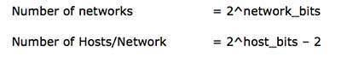
Internet Protocol: IPv4 - Address Space (Cntd.)
The number of networks and the number of hosts per class can be derived by this formula:
When calculating hosts' IP addresses, 2 IP addresses are decreased because they cannot be assigned to hosts.
The first IP of a network is network number
The last IP is reserved for Broadcast IP.

Slide 53
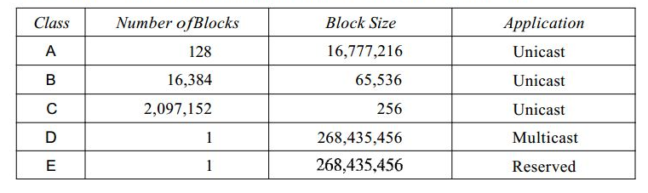
Classes and Blocks

Slide 54
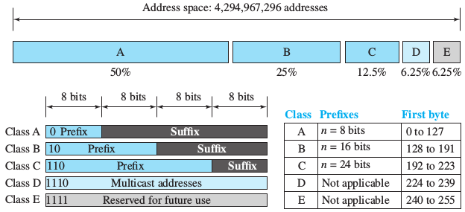
Internet Protocol: IPv4 - Classful Addressing

Slide 55
Internet Protocol: IPv4 - Classful Addressing
“Class A” Address:
The first bit of the first octet is always set to 0 (zero). Thus the first octet ranges from 1–127.
Class A addresses only include IP starting from 1.x.x.x to 126.x.x.x only. The IP range 127.x.x.x is reserved for loopback IP addresses.
The default subnet mask for Class A IP address is 255.0.0.0 which implies that Class A addressing can have 126 (2⁷) networks and 16777214 (2²⁴-2) hosts .
Class A IP address format is thus:
0NNNNNNN.HHHHHHHH.HHHHHHHH.HHHHHHHH

Slide 56
Internet Protocol: IPv4 - Classful Addressing (Cntd.)
2. “Class B” Address:
An IP address which belongs to class B has the first two bits in the first octet set to 10.
IP Addresses range from 128.0.x.x to 191.255.x.x. The default subnet mask for Class B is 255.255.x.x.
Class B has 16384 (2¹⁴) Network addresses and 65534 (2¹⁶-2) Host addresses.
Class B IP address format is thus:
10NNNNNN.NNNNNNNN.HHHHHHHH.HHHHHHHH

Slide 57
Internet Protocol: IPv4 - Classful Addressing (Cntd.)
3. “Class C” Address:
The first octet of Class C IP address has its first 3 bits set to 110.
Class C IP addresses range from 192.0.0.x to 223.255.255.x. The default subnet mask for Class C is 255.255.255.x.
Class C gives 2097152 (2²¹) Network addresses and 254 (2⁸-2) Host addresses.
Class C IP address format is thus:
110NNNNN.NNNNNNNN.NNNNNNNN.HHHHHHHH

Slide 58
Internet Protocol: IPv4 - Classful Addressing (Cntd.)
4. “Class D” Address:
Very first four bits of the first octet in Class D IP addresses are set to 1110. Giving range of 11100000-11101111 (224-239)
Class D has IP address rage from 224.0.0.0 to 239.255.255.255.
Class D is reserved for Multicasting.
In multicasting data is not destined for a particular host, that is why there is no need to extract host address from the IP address,
Class D does not have any subnet mask.

Slide 59
Internet Protocol: IPv4 - Classful Addressing (Cntd.)
“Class E” Address:
This IP Class is reserved for experimental purposes only for R&D or Study.
11110000-11111111
240-255
IP addresses in this class ranges from 240.0.0.0 to 255.255.255.254.
Like Class D, this class too is not equipped with any subnet mask.

Slide 60
Sample Examples
Question 1: Given the network address 17.0.0.0, find the class, the block, and the range of the addresses.
Solution:
The class is A because the first byte is between 0 and 127.
The block has a netid of 17.
The addresses range from 17.0.0.0 to 17.255.255.255.

Slide 61
Sample Examples
Question 2: Given the network address 132.21.0.0, find the class, the block, and the range of the addresses.
Solution:
The class is B because the first byte is between 128 and 191.
The block has a netid of 132.21. The addresses range from 132.21.0.0 to 132.21.255.255.

Slide 62
Sample Examples
Question 3: Given the network address 220.34.76.0,find the class,the block,and the range of the addresses.
Solution:
The class is C because the first byte is between 192 and 223.
The block has a netid of 220.34.76.
The addresses range from 220.34.76.0 to 220.34.76.255.

Slide 63
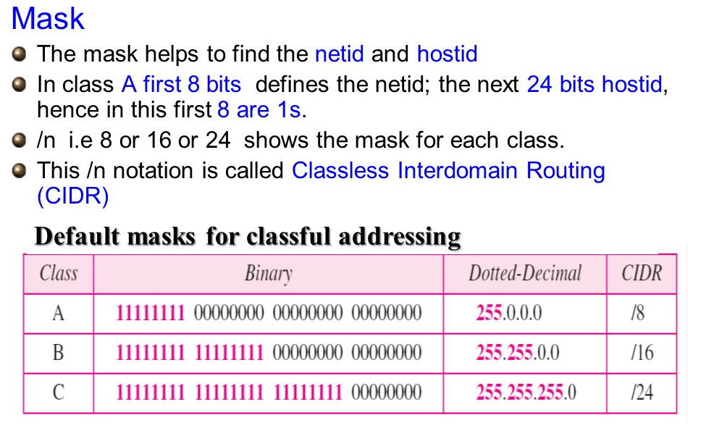
MASK

Slide 64
Classless Addressing
Classless Addressing is an improved IP Addressing system.
It makes the allocation of IP Addresses more efficient.
It replaces the older classful addressing system based on classes.
It is also known as Classless Inter Domain Routing (CIDR).
Why Classless?.
To overcome address depletion
Give access of Internet to more organizations
There are no classes but addresses are still granted in blocks

Slide 65
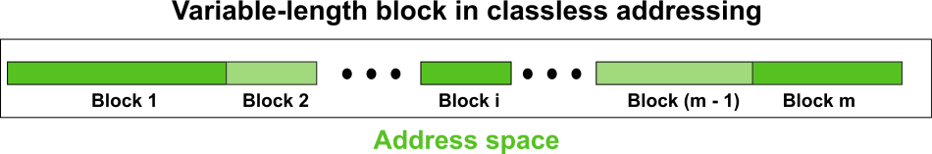
Classless Addressing
The entire address space is partitioned into blocks of varying lengths with classless addressing.
An address's prefix designates the block (network); its suffix designates the node (device).
It is capable of having a block of 20, 21, 22 ,..., 232 addresses, theoretically.
One of the limitations is that a block of addresses must have a power of two addresses.
One address block may be given to an organization.

Slide 66
Classless Addressing
In contrast to classful addressing, classless addressing allows for varying prefix lengths.
Prefix lengths that vary from 0 to 32 are possible.
The length of the prefix has an inverse relationship with network size.
A smaller network has a large prefix; a larger one has a small prefix.
classless addressing is a specific instance of classful addressing.
An address in class A can be considered as a classless address with a prefix length of 8.
Class B addresses can be viewed as classless addresses with the prefix 16

Slide 67
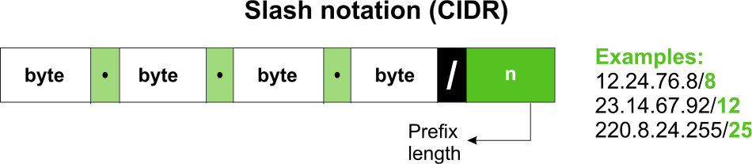
Classless Addressing
In classless addressing, the prefix length is to be provided because it is not a property of the address.
A classless address does not automatically define the block or network to which it belongs.
The address is inserted in this scenario, followed by a slash, and the prefix length, n.

Slide 68
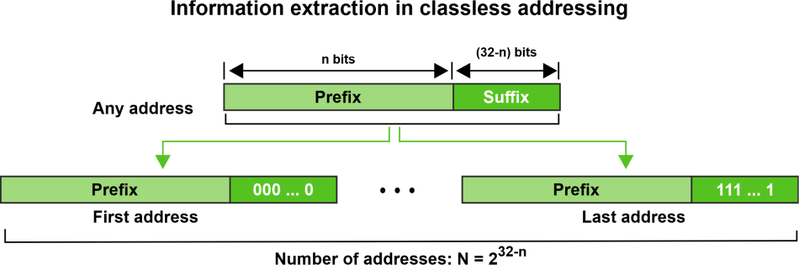
Classless Addressing
With respect to any given address in the block, we typically like to know three things:
the number of addresses in the block,
the start address in the block,
the last address.

Slide 69
Classless Addressing
The block has N = 2^{32-n} addresses, according to the calculation.
The n leftmost bits are kept, and the (32 - n) rightmost bits are all set to zeroes to determine the first address.
The n leftmost bits are kept, while the (32 - n) rightmost bits are all set to 1s to determine the last address.

Slide 70
Classless Addressing
For the given classless address 167.199.170.82/27 find the number of addresses in the block, the start address in the block, and the last address.
Solution:
The first 27 bits are kept while the remaining bits are converted to 0s to determine the first address.
There are 2^{32-n} = 2⁵ = 32 addresses in all.

Slide 71
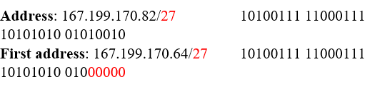
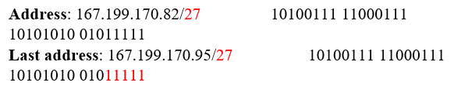
Classless Addressing
The first 27 bits are kept while the remaining bits are converted to 0s to determine the first address.
Keeping the first 27 bits and turning the remaining bits to 1s will allow you to determine the last address.

Slide 72
Classless Addressing
Network Address and Mask:
Network address:
It identifies a network on internet.
Using this, we can find range of addresses in the network and total possible number of hosts in the network.
Mask:
It is a 32-bit binary number that gives the network address in the address block when bitwise AND operation is applied on the mask and any IP address of the block.

Slide 73
Classless Addressing
Network Address and Mask
In IPv4 addressing, a block of addresses can be defined as
x.y.z.t /n Ex. 192.168.1.1/28
In which x.y.z.t defines one of the addresses and /n defines the mask

Slide 74
Classless Addressing
Subnetting:
Dividing a large block of addresses into several contiguous sub-blocks and assigning these sub-blocks to different smaller networks is called subnetting.
It is a practice that is widely used when classless addressing is done.

Slide 75
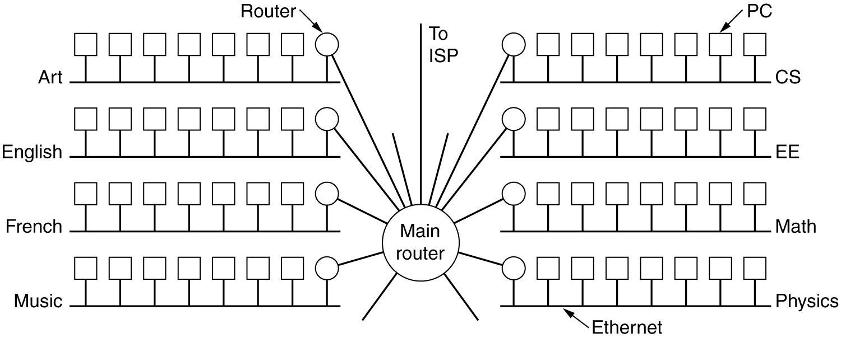
Subnets
Figure: LAN: Campus network for various departments.

Slide 76
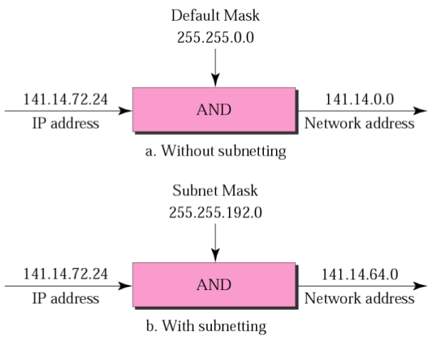
Subnets: Default Mask vs Subnet Mask
192 = 11000000
72 = 01001000
Bitwise AND = 01000000 = 64

Slide 77
Classless Addressing – Subnetting
To reduce the wastage of IP addresses in a block, we use sub-netting.
Some of the Host id bits are used as net id bits of a classful IP address.
We give the IP address and define the number of bits for mask along with it (usually followed by a ‘/’ symbol), like, 192.168.1.1/28.
Subnet mask is found by putting the given number of bits out of 32 as 1
Ex: In the given address, we need to put 28 out of 32 bits as 1 and the rest as 0, and so, the subnet mask would be 255.255.255.240.

Slide 78
Classless Addressing
Some values calculated in subnetting :
1. Number of subnets : Given bits for mask – No. of bits in default mask
2. Subnet address : AND result of subnet mask and the given IP address
3. Broadcast address : By putting the host bits as 1 and retaining the network bits as in the IP address
4. Number of hosts per subnet : 2^{(32 – Given bits for mask)} – 2
5. First Host ID : Subnet address + 1 (adding one to the binary representation of the subnet address)
6. Last Host ID : Subnet address + Number of Hosts

Slide 79
Classless Addressing (1st Method)
Some values calculated in subnetting :
The first address in the block can be found out by setting the rightmost 32-n bits to 0s
The last address in the block can be found out by setting the rightmost 32-n bits to 1s
Ex: A block of addresses is granted to a small organization. One of the address is 205.16.37.39/28. What is first and last address?
Solution:
Binary representation of given address: 11001101 00010000 00100101 00100111
Binary representation of mask: 11111111 11111111 11111111 11110000
First address : 11001101 00010000 00100101 00100000 = 205.16.37.32
Last address : 11001101 00010000 00100101 00101111 = 205.16.37.47
No. of addresses = 2^(32 -28) = 2^4 = 16

Slide 80
Classless Addressing (2nd Method)
Ex: A block of addresses is granted to a small organization. One of the address is 205.16.37.39/28. What is first and last address?
Binary representation of given address: 11001101 00010000 00100101 00100111
Binary representation of mask: 11111111 11111111 11111111 11110000
First address : Bitwise AND operation of given address and mask = 205.16.37.32
Last address : Take compliment of the mask and do bitwise OR operation
Given address: 11001101 00010000 00100101 00100111
Compliment of the mask: 000000000 00000000 00000000 00001111 = 205.16.37.47
No. of addresses :
Compliment of the mask + 1 = 000000000 00000000 00000000 00001111 + 1 = 16

Slide 81
Classless Addressing – Subnetting
Problem:
An Organization is given a block 17.12.14.0/26, which contains 64 addresses. The organization has 3 offices and needs to divide the addresses into 3 subblocks of 32, 16 and 16.
How the subnetting will be performed?.

Slide 82
Classless Addressing – Solution – How?
We need to decide the mask for subnetting
Suppose the mask for Subnet 1 is n1 then 2^(32-n1) = 32 means n1 = 27
Suppose the mask for Subnet 2 is n2 then 2^(32-n2) = 16 means n2 = 28
Suppose the mask for Subnet 3 is n3 then 2^(32-n3) = 16 means n3 = 28
So We must have masks 27, 28 and 28 with the organization mask being 26.

Slide 83
Classless Addressing – Solution – How?
First and Last addresses for Subnet 1
Block 1 = 32 addresses
Mask for Subnet 1 is n1 then 2^(32-n1) = 32 means n1 = 27
Mask is /27 = 11111111 11111111 11111111 11100000
First Address: 00010001 00001100 00001110 00000000 = 17.12.14.0
Last Address: 00010001 00001100 00001110 00011111 = 17.12.14.31
Example of address from Subnet 1
17.12.14.29 /27

Slide 84
Classless Addressing – Solution – How?
First and Last addresses for Subnet 2
Block 2 = 16 addresses
Given Addresses: 17.12.14.0 = 00010001 00001100 00001110 00101101
Mask for Subnet 2 is n2 then 2^(32-n2) = 16 means n2 = 28
Mask is /28 = 11111111 11111111 11111111 11110000
First Address: 00010001 00001100 00001110 00100000 = 17.12.14.32
Last Address: 00010001 00001100 00001110 00101111 = 17.12.14.47
Example of address from Subnet 2
17.12.14.45 /28

Slide 85
Classless Addressing – Solution – How?
First and Last addresses for Subnet 2
Block 2 = 16 addresses
Given Addresses: 17.12.14.0 = 00010001 00001100 00001110 00101101
Mask for Subnet 3 is n3 then 2^(32-n3) = 16 means n3 = 28
Mask is /28 = 11111111 11111111 11111111 11110000
First Address: 00010001 00001100 00001110 00110000 = 17.12.14.48
Last Address: 00010001 00001100 00001110 00111111 = 17.12.14.63
Example of address from Subnet 3
17.12.14.50 /28

Slide 86
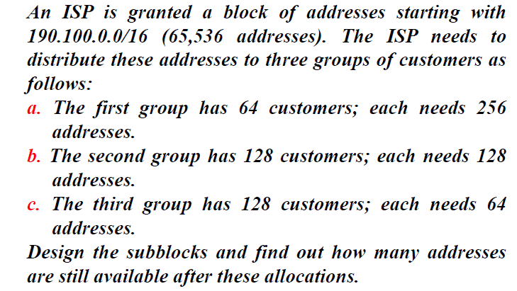
Question:

Slide 87
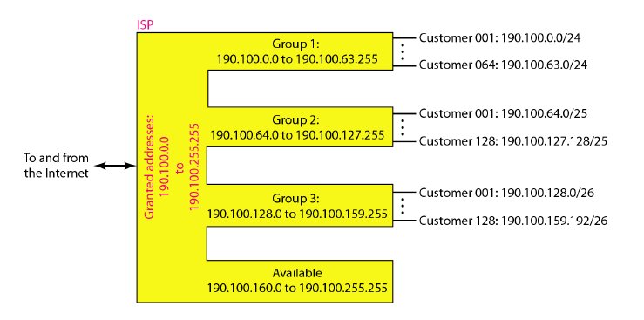

Slide 88
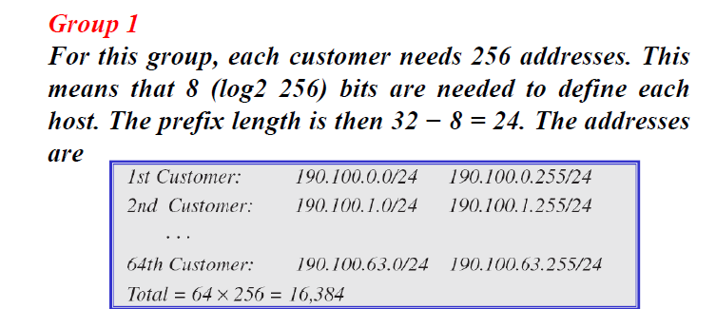

Slide 89
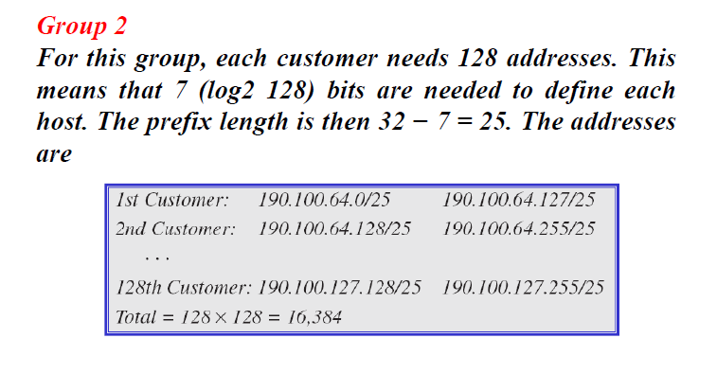

Slide 90
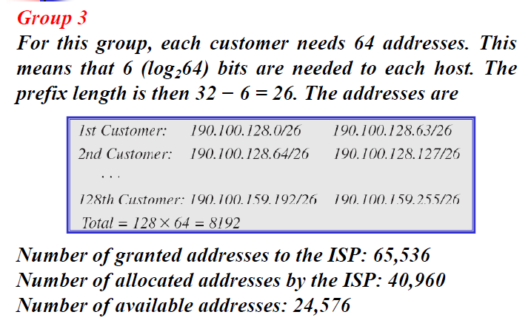

Slide 91
Example :
Given IP Address – 172.16.0.0/25, find the number of subnets and the number of hosts per subnet. Also, for the first subnet block, find the subnet address, first host ID, last host ID and broadcast address.
Solution :
This is a class B address. So, no. of subnets = 2^(25-16) = 2^9 = 512.
No. of hosts per subnet = 2^(32-25) – 2 = 2^7 – 2 = 128 – 2 = 126
For the first subnet block(means Subnet Number=1), we have subnet address = 172.16.0.0, first host id = 172.16.0.1, last host id = 172.16.0.126 and broadcast address = 172.16.0.127

Slide 92
Sample Examples
Question 1: A company is granted the site address 201.70.64.0 (class C). The company needs six subnets. Design the subnets.
Solution:
The number of 1s in the default mask is 24 (class C).
The company needs six subnets.This number 6 is not a power of 2.
The next number that is a power of 2 is 8 (2^3 =8).
We need 3 more 1s in the subnet mask.
The total number of 1s in the subnet mask is 27 (24+3).
The total number of 0s is 5 (32 - 27).
The mask is 11111111 11111111 11111111 11100000 or 255.255.255.224
The number of subnets is 8 [2^(27-24) = 2^3=8]
Addresses in each subnet are 32.

Slide 93
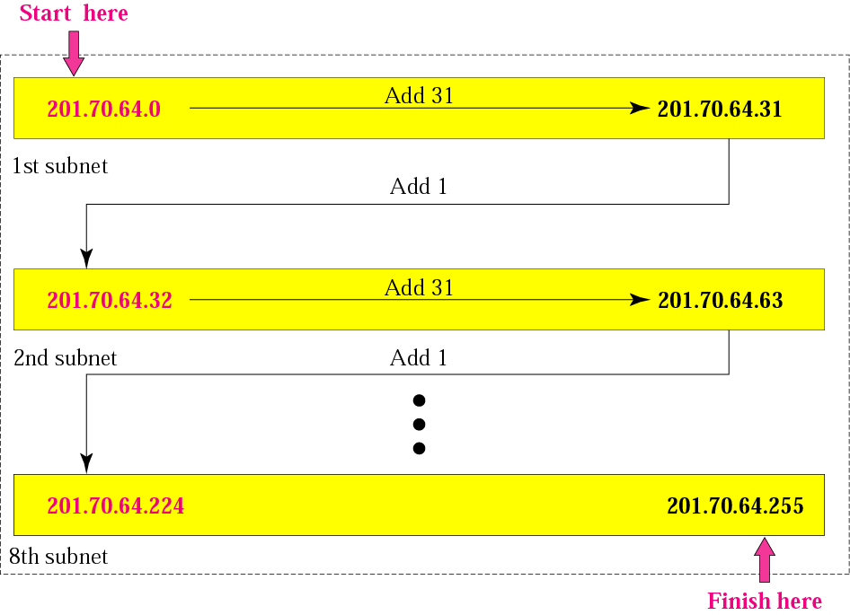
Sample Examples

Slide 94
Sample Examples
Question 2: An organization is granted the block 130.34.12.64/26. The organization needs to have four subnets.What are the subnet addresses and the range of addresses for each subnet?
Solution:
The suffix length is 6.This means the total number of addresses in the block is 64(2⁶). If we create four subnets,each subnet will have 16 addresses.
Let us first find the subnet prefix (subnet mask). We need four subnets, which means we need to add two more 1s to the site prefix. The subnet prefix is then /28.
Solution: (Cntd.)
Subnet 1: 130.34.12.64/28 to 130.34.12.79/28.
Subnet 2 : 130.34.12.80/28 to 130.34.12.95/28.
Subnet 3: 130.34.12.96/28 to 130.34.12.111/28.
Subnet 4: 130.34.12.112/28 to 130.34.12.127/28

Slide 95
Sample Examples
Solution: (Cntd.)
Subnet 1: 130.34.12.64/28 to 130.34.12.79/28.
Subnet 2 : 130.34.12.80/28 to 130.34.12.95/28.
Subnet 3: 130.34.12.96/28 to 130.34.12.111/28.
Subnet 4: 130.34.12.112/28 to 130.34.12.127/28.

Slide 96
Sample Examples
Question 1: A block of addresses is granted to a small organization. We know that one of the addresses is 205.16.37.39/28. What is the first address in the block?
Solution:
The binary representation of the given address is
11001101 00010000 00100101 00100111
Mask is
11111111 11111111 11111111 11110000
If we set 32−28 rightmost bits to 0, we get
11001101 00010000 00100101 0010000 or 205.16.37.32.

Slide 97
Sample Examples
Question 2: What is the network address if one of the addresses is 167.199.170.82/27?
Solution:
The prefix length is 27,which means that we must keep the first 27 bits as 1s and change the remaining bits(5) to 0s. The 5 bits affect only the last byte. The last byte is 01010010. Changing the last 5 bits to 0s, we get 01000000 or 64. The network address is 167.199.170.64/27.

Slide 98
Sample Examples
Question 3: A small organization is given a block with the beginning address and the prefix length 205.16.37.24/29 (in slash notation). What is the range of the block?
Solution:
The beginning address is 205.16.37.24.To find the last address we keep the first 29 bits and change the last 3 bits to1s.
Beginning: 11001111 00010000 00100101 00011000
Ending: 11001111 00010000 00100101 00011111
There are only 8 addresses in this block.

Slide 99
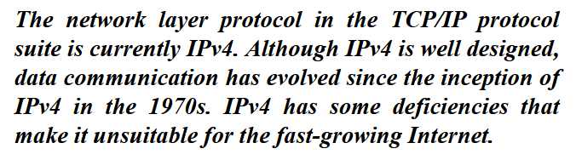
Internet Protocol: IPv6

Slide 100
Internet Protocol: IPv6
Initial motivation:
32-bit address space soon to be completely allocated
Additional motivation:
header format helps speed processing/forwarding
header changes to facilitate QoS
IPv6 datagram format:
Fixed length 40-byte header
fragmentation not allowed

Slide 101
Internet Protocol: IPv6 Goals
Support billions of hosts
Reduce routing table size
Simplify protocol
Better security
Attention to type of service
Aid multicasting
Roaming host without changing address
Allow future protocol evolution
Permit coexistence of old, new protocols. . .

Slide 102
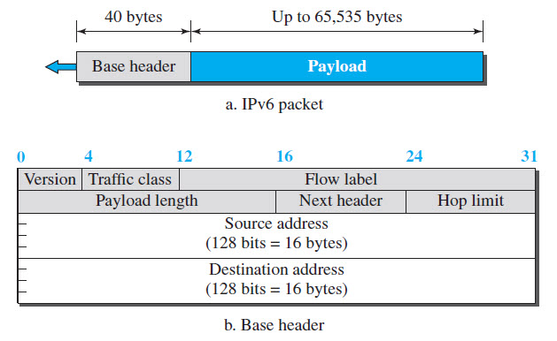
Internet Protocol: IPv6 Header

Slide 103
Internet Protocol: IPv6 Header
Version (4-bits): Indicates version of Internet Protocol which contains bit sequence 0110.
Traffic Class (8-bits): The Traffic Class field indicates class or priority of IPv6 packet which is similar to Service Field in IPv4 packet. It helps routers to handle the traffic based on the priority of the packet. If congestion occurs on the router then packets with the least priority will be discarded.
Flow Label (20-bits): Flow Label field is used by a source to label the packets belonging to the same flow in order to request special handling by intermediate IPv6 routers, such as non-default quality of service or real-time service.
Payload Length (16-bits): It is a 16-bit (unsigned integer) field, indicates the total size of the payload which tells routers about the amount of information a particular packet contains in its payload. The payload Length field includes extension headers(if any) and an upper-layer packet.

Slide 104
Internet Protocol: IPv6 Header
Next Header (8-bits): Next Header indicates the type of extension header(if present) immediately following the IPv6 header. Whereas In some cases it indicates the protocols contained within upper-layer packets, such as TCP, UDP.
Hop Limit (8-bits): Hop Limit field indicates the maximum number of intermediate nodes IPv6 packet is allowed to travel.
Source Address (128-bits): Source Address is the 128-bit IPv6 address of the original source of the packet.
Destination Address (128-bits): The destination Address field indicates the IPv6 address of the final destination. All the intermediate nodes can use this information in order to correctly route the packet.

Slide 105
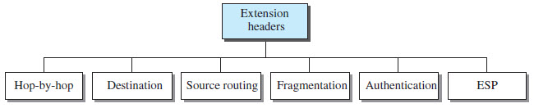
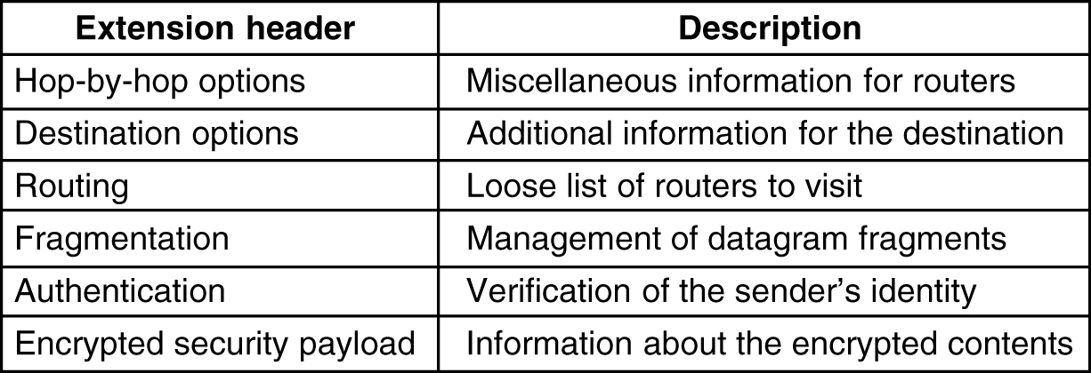
Internet Protocol: IPv6 Header
Extension Headers: In order to rectify the limitations of the IPv4 Option Field, Extension Headers are introduced in IP version 6.

Slide 106
NAT – Network Address Translation
NAT stands for network address translation.
To access the Internet, one public IP address is needed
The idea of NAT is to allow multiple devices to access the Internet through a single public address.
It's a way to map multiple private addresses inside a local network to a public IP address before transferring the information onto the internet.
NAT does the translation of port numbers i.e. masks the port number of the host with another port number, in the packet that will be routed to the destination
Organizations that want multiple devices to employ a single IP address use NAT, as do most home routers.
Cable modem or DSL router at home provides NAT to all connections at home.

Slide 107
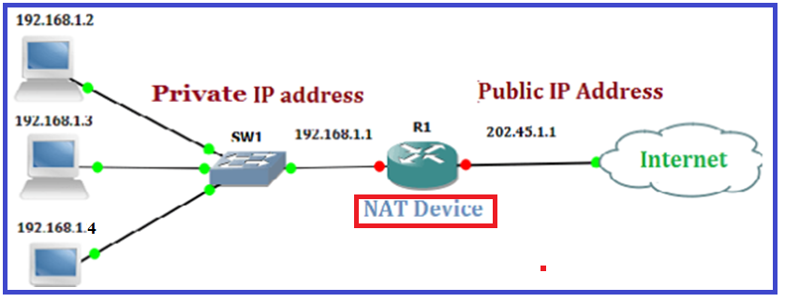
NAT – Network Address Translation

Slide 108
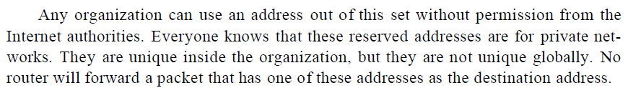
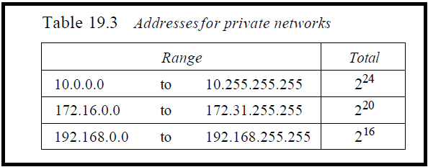
Private Addresses Range

Slide 109
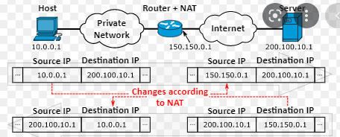
NAT – Network Address Translation

Slide 110
Advantages of NAT
The number of devices accessing the internet far surpasses the number of IP addresses available.
Routing all of these devices via one connection using NAT helps to consolidate multiple private IP addresses into one public IP address.
This helps to keep more public IP addresses available even while private IP addresses proliferate.

Slide 111
ARP and RARP
The logical addresses in TCP/IP protocol suite are IP addresses
Physical address is usually implemented in hardware
Ex) 48-bit MAC addresses in Ethernet is imprinted on the NIC installed in the host.

Slide 112
Mapping
Mapping a logical address to its corresponding physical address
Static mapping
means creating a table that associates a logical address with a physical address
need to update periodically
Dynamic mapping
each time a machine knows one of the two addresses (logical or physical), it can use a protocol to find the other one
ARP (address resolution protocol), RARP (reverse address resolution protocol)

Slide 113
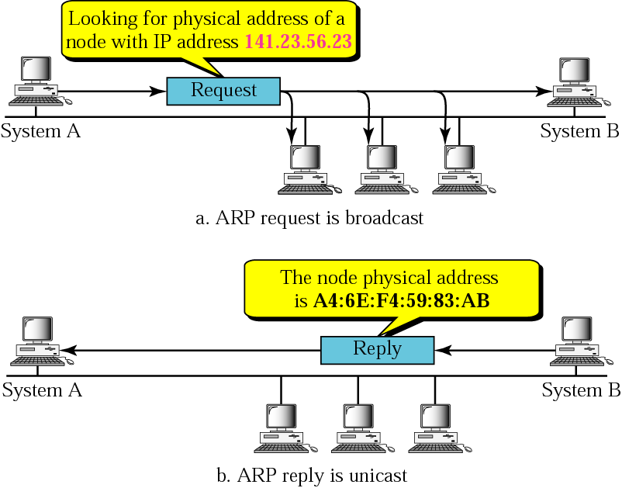
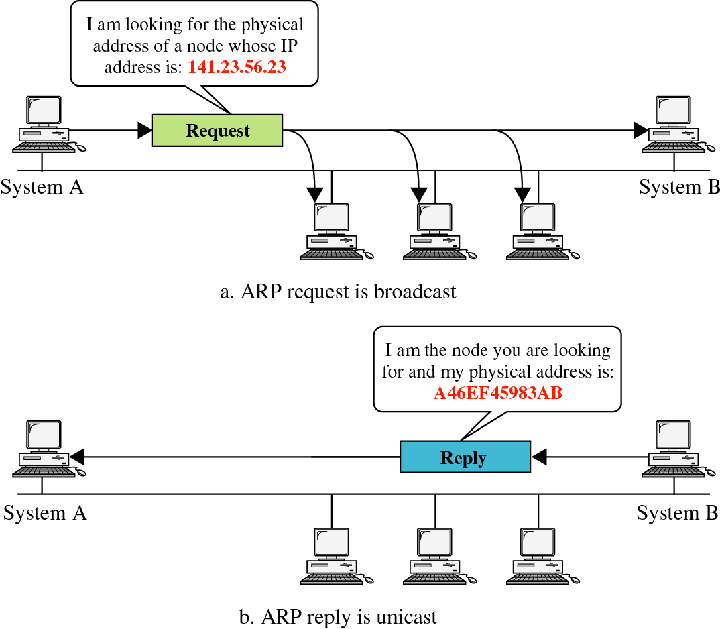
ARP Operation

Slide 114
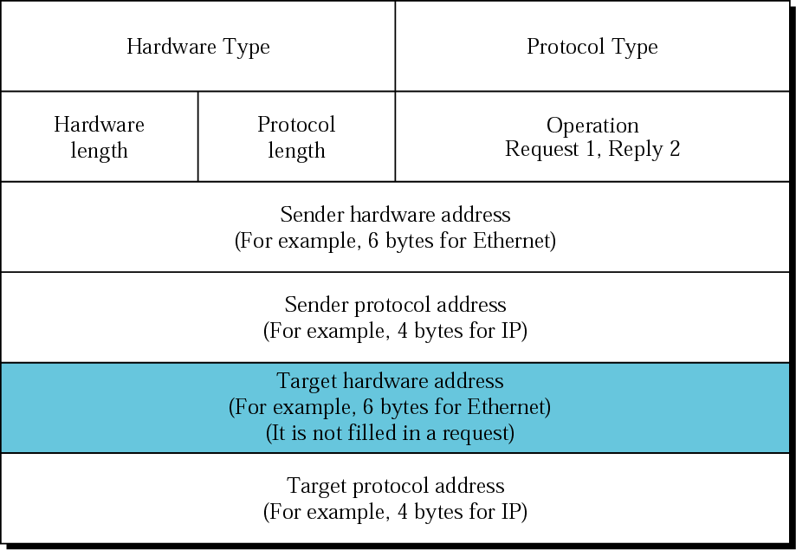
ARP Packet
Hardware
Type - Ethernet
is type 1
Protocol Type-
IPv4=x0800
Hardware
Length:length of
Ethernet
Address (6)
Protocol
Length:length of
IPv4 address (4)

Slide 115
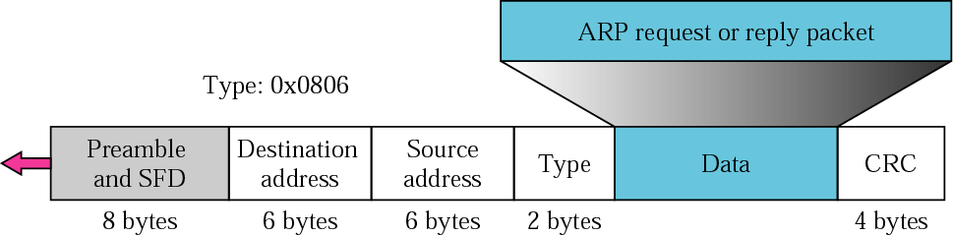
Encapsulation of ARP Packet
The ARP packet is encapsulated within an Ethernet packet.
Note: Type field for Ethernet is x0806

Slide 116
The Cache Table
If ARP just resolved an IP address, chances are a few moments later someone is going to ask to resolve the same IP address
When ARP returns a MAC address, it is placed in a cache. When the next request comes in for the same IP address, look first in the cache

Slide 117
RARP
To create an IP datagram, a host or a router needs to know its own IP address or addresses
The IP address of a machine is usually read from its configuration file stored on a disk file
A diskless machine is usually booted from ROM, which has minimum booting information
It cannot include the IP address because the IP addresses on a network are assigned by the administrator.
The machine can get its physical address by reading its NIC.

Slide 118
RARP
RARP finds the logical address for a machine that only knows its physical address.
This if often encountered on thin-client workstations. No disk, so when machine is booted, it needs to know its IP address (don’t want to burn the IP address into the ROM).
RARP requests are broadcast, RARP replies are unicast.
If a thin-client workstation needs to know its IP address, it probably
also needs to know its subnet mask, router address, DNS address, etc.
So we need something more than RARP. BOOTP, and now DHCP have replaced RARP.

Slide 119
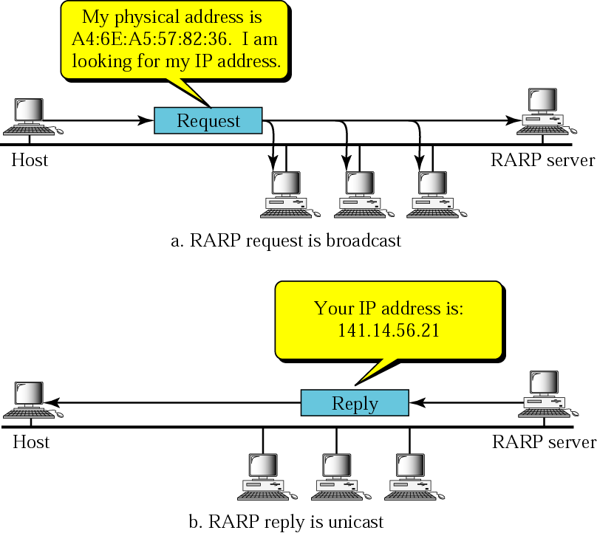
RARP Operation

Slide 120
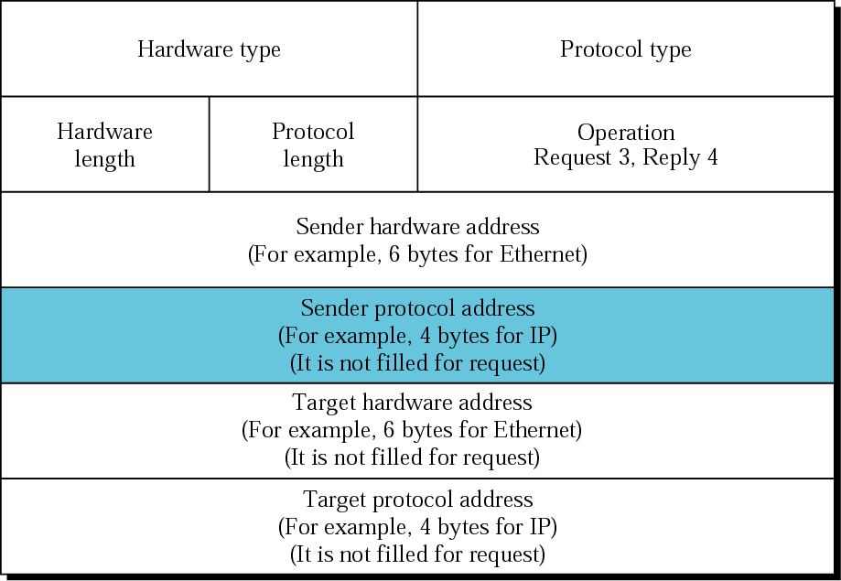
RARP Packet Format

Slide 121
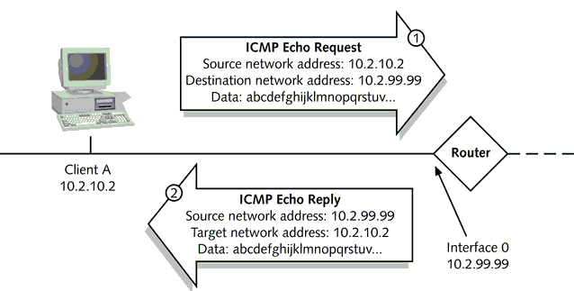
Internet Control Message Protocols [ICMP]
ICMP’s most common uses are Testing and Troubleshooting.
Two of the most well-known utilities, PING and TRACEROUTE, rely on ICMP to perform connectivity tests and path discovery.
ICMP-----Error Reporting messages

Slide 122
Internet Control Message Protocols [ICMP]
The Internet Control Message Protocol (ICMP) is a network layer protocol used by network devices to diagnose network communication issues.
ICMP messages communicate information about network connectivity issues back to the source of the compromised transmission.
ICMP is mainly used to determine whether or not data is reaching its intended destination in a timely manner.
It sends control messages such as destination network unreachable, source route failed, and source quench.
Commonly, the ICMP protocol is used on network devices, such as routers. ICMP is crucial for error reporting and testing, but it can also be used in distributed denial-of-service (DDoS) attacks.

Slide 123
Internet Control Message Protocols [ICMP]
Error reporting (e.g.)
If a packet of data is too large for a router, the router will drop the packet and send an ICMP message back to the original source for the data.
Network diagnostics:
The terminal utilities traceroute and ping both operate using ICMP
The traceroute utility is used to display the routing path between two Internet devices. traceroute also reports the time required for each hop along the way which is used to find the delay
The ping utility is a simplified version of traceroute. A ping will test the speed of the connection between two devices and report exactly how long it takes a packet of data to reach its destination and come back to the sender’s device

Slide 124
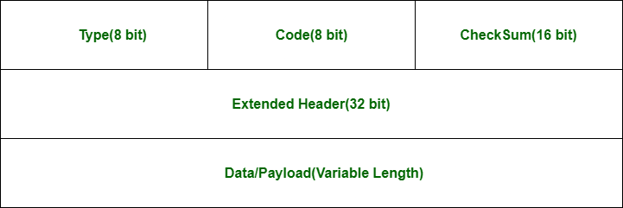
Internet Control Message Protocols [ICMP]
An ICMP packet is a packet that uses the ICMP protocol.
ICMP packets include an ICMP header after a normal IP header.
When a router or server needs to send an error message, the ICMP packet body or data section always contains a copy of the IP header of the packet that caused the error.

Slide 125
Internet Control Message Protocols [ICMP]
Type (8-bit): The initial 8-bit of the packet is for message type
Code (8-bit): This field carries some additional information about the error message and type.
Checksum (16-bit): The checksum is used to check the number of bits of the complete message and enable the ICMP tool to ensure that complete data is delivered.
Extended Header (32 bits): which has the work of pointing out the problem in IP Message
Data or Payload: It is of variable length. The bytes included in IPv4 are 576 bytes and in IPv6, 1280 bytes.

Slide 126
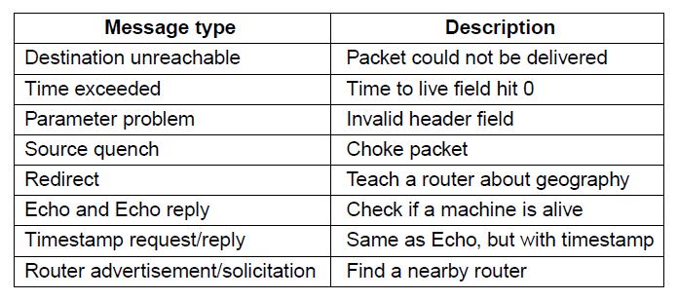
Internet Control Message Protocols [ICMP]

Slide 127
Routing Algorithm
Routing Protocols are the set of defined rules used by the routers to communicate between source & destination.
They are mechanisms by which routing information is exchanged between routers so that routing decisions can be made.
They do not move the information to the source to a destination, but only update the routing table that contains the information.
It allows the network to select routes between any two nodes on a computer network.

Slide 128
Routing Algorithm
Routing Protocol
Static
Dynamic

Slide 129
Static of Routing Protocol
Static routing is a form of routing that occurs when a router uses a manually-configured routing entry.
It does not use information from dynamic routing traffic.
In many cases, static routes are manually configured by a network administrator by adding in entries into a routing table

Slide 130
Static Routing Protocol
Advantages
No overhead on router CPU.
No unused bandwidth between links.
Only the administrator is able to add routes
Disadvantages
The administrator must know how each router is connected.
Not an ideal option for large networks as it is time intensive.
Whenever link fails all the network goes down which is not feasible in small networks.

Slide 131
Dynamic Routing Protocol
Dynamic protocols help routers to add information to their routing tables from connected routers automatically.
These types of protocols also send out topology updates whenever the network changes its topological structure.
Advantage
Easier to configure even on larger networks.
It will be dynamically able to choose a different route in case if a link goes down.
It helps you to do load balancing between multiple links.
Disadvantage
Updates are shared between routers, so it consumes bandwidth.
Routing protocols put an additional load on router CPU or RAM.

Slide 132
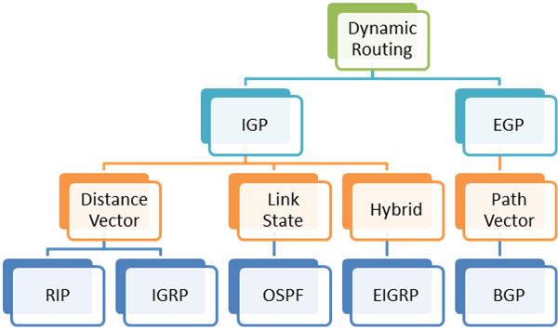
Dynamic of Routing Protocol

Slide 133
Dynamic of Routing Protocol
Interior gateway (IGP):
Interior gateway protocols usually exchange information with other routers within single autonomous systems.
These systems can include one routing network or a group of networks operating under the same control.
Exterior gateway protocols (EGP):
Exterior gateway protocols communicate information between routing networks in different autonomous systems.
Typically, because they're in different systems, this process is more complex and potentially less common.

Slide 134
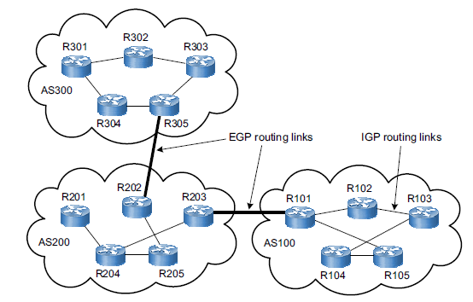
Dynamic of Routing Protocol
An autonomous system is a group of networks and routers under the authority of single administration.
Routing inside an AS is called as “Intradomain routing”.
Routing between AS is called as “Interdomain routing”.

Slide 135
Three common routing protocols
There are three types of routing protocols commonly used.
Distance Vector - RIP
Link State - OSPF
Path vector - BGP

Slide 136
Distance Vector routing protocols
Distance vector protocols can measure the distance it takes data to arrive at its destination within a system or application.
Distances, based on a chosen metric, are computed using information from the neighbors’ distance vectors.
Metric: usually hops / delay / cost
Distance Vector Protocols advertise their routing table to every directly connected neighbor at specific time intervals using lots of bandwidths and slow converge.
In the Distance Vector routing protocol, when a route becomes unavailable, all routing tables need to be updated with new information.
The distance vector routing algorithm is sometimes called by Bellman-Ford routing algorithm,

Slide 137

Distance Vector Routing Tables
Basic idea: each network node maintains a Distance Vector table containing the distance between itself and ALL possible destination nodes.

Slide 138

Initialization of Tables in Distance Vector Routing

Slide 139

Sharing of Tables in Distance Vector Routing

Slide 140

Updating in Distance Vector Routing Table Example: C to A

Slide 141

When to share

Slide 142

Two-node instability

Slide 143
Two-node instability
Defining Infinity
– Most implementations define 16 as infinity
• Split Horizon
– Instead of flooding the table through each
interface, each node sends only part of its table
through each interface
– E.g. node B thinks that the optimum route to
reach X is via A, it does not need to advertise this
piece of information to A

Slide 144
Two-node instability
Split Horizon and Poison Reverse
– One drawback of Split Horizon
• Normally, the DV protocol uses a timer and if there is no
news about a route, the node deletes the route from its
table
• In the previous e.g., node A cannot guess that this is
due to split horizon or because B has not received any
news about X recently
– Poison Reverse
• Node B can still advertise the value for X, but if the
source of information is A, it can replace the distance
with infinity as a warning

Slide 145
Distance Vector routing protocols
Features:
A router transmits its distance vector to each of its neighbors in a routing packet.
Each router receives and saves the most recently received distance vector from each of its neighbors.
A router recalculates its distance vector when:
It receives a distance vector from a neighbor containing different information than before.
It discovers that a link to a neighbor has gone down.
Routers always trust routing information received from neighbor routers. This is also known as routing on rumors.
Disadvantages:
As the routing information is exchanged periodically, unnecessary traffic is generated which consumes available bandwidth.
As full routing tables are exchanged, therefore it has security issues. If an un-authorized person enters the network, then the whole topology will be very easy to understand.

Slide 146
Routing information protocol
RIP, an interior gateway protocol, is one of the first protocols created.
It is a distance vector protocol
it is used in local area networks (LANs) and wide area networks (WANs)
There are two different versions of this protocol type: RIPv1 and RIPv2.
A simple intra domain protocol
Straightforward implementation of Distance Vector Routing
Each router advertises its distance vector every 30 seconds (or whenever its routing table changes) to all of its neighbors
RIP always uses 1 as link metric
Maximum hop count is 15, with “16” equal to “∞”
Routes are timeout (set to 16) after 3 minutes if they are not updated.

Slide 147
RIPv1
The original version or RIPv1 helps you determine network paths based on the IP destination and the hop count journey.
RIPv1 also interacts with the network by broadcasting its IP table to all routers connected with the network.
RIPv1, the original version, is a classful protocol that examines and evaluates network paths based on the hops to the pre-determined destination.

Slide 148
RIPv2
RIPv2 is an extends RIPv1:
Subnet masks are carried in the route information
Authentication of routing messages
Route information carries next-hop address
Exploites IP multicasting
Extensions of RIPv2 are carried in unused fields of RIPv1 messages

Slide 149


RIP-Advantages and Disadvantages

Slide 150
Link State routing
These protocols know more about Internetwork than any other distance vector routing protocol.
These are also known as SPF (Shortest Path First) protocol. OSPF is an example of link-state routing protocol.
Features
Hello messages, also known as keep-alive messages are used for neighbor discovery and recovery.
Concept of triggered updates is used i.e updates are triggered only when there is a topology change.
Only that many updates are exchanged which is requested by the neighbor router.
Link state protocols send information about directly connected links to all the routers in the network

Slide 151
Link State routing
Link state routing protocol maintains three tables namely:
Neighbor table- the table which contains information about the neighbors of the router only, i.e, to which adjacency has been formed.
Topology table- This table contains information about the whole topology i.e contains both best and backup routes to a particular advertised networks.
Routing table- This table contains all the best routes to the advertised network.

Slide 152
Link State routing
Link state routing has a different philosophy from that of
distance vector routing.
In link state routing, if each node in the domain has the
entire topology of the domain—the list of nodes and links,
how they are connected including the type, cost (metric),
and the condition of the links (up or down)—the node can
use the Dijkstra algorithm to build a routing table.

Slide 153

Link State knowledge

Slide 154
Building Routing Tables
Creation of the states of the links by each node, called the link state packets (LSP)
Dissemination of LSPs to every other routers, called flooding (efficiently)
Formation of a shortest path tree for each node
Calculation of a routing table based on the shortest path tree

Slide 155
Creation of LSP
LSP data: E.g. the node ID, the list of links, a sequence number, and age.
• LSP Generation
– When there is a change in the topology of the domain
– On a periodic basis
• There is no actual need for this type of LSP, normally 60 minutes or 2 hours

Slide 156

Dijkstra Algorithm

Slide 157

Example of formation of shortest path tree

Slide 158
Link State routing
Advantages –
As it maintains separate tables for both the best route and the backup routes ( whole topology) therefore it has more knowledge of the internetwork than any other distance vector routing protocol.
Concept of triggered updates is used therefore no more unnecessary bandwidth consumption is seen like in distance vector routing protocol.
Partial updates are triggered when there is a topology change, not a full update like distance vector routing protocol where the whole routing table is exchanged.
Link state routing protocols are widely used in large networks due to their fast convergence and high reliability

Slide 159
Link State routing
Disadvantages –
The main disadvantage of a link state routing protocol is that it does not scale well as more routers are added to the routing domain.
Increasing the number of routers increases the size and frequency of the topology updates, and also the length of time it takes to calculate end-to-end routes.
This lack of scalability means that a link state routing protocol is unsuitable for routing across the Internet at large, which is the reason why IGPs only route traffic within a single AS.

Slide 160
Open Shortest Path First [OSPF]
Open Shortest Path First (OSPF) protocol is a link-state IGP tailor-made for IP networks using the Shortest Path First (SPF) method.
OSPF routing maintains databases detailing information about the surrounding topology of the network.
It also uses the Dijkstra algorithm (Shortest path algorithm) to recalculate network paths when its topology changes.
Internally, it maintains multiple databases with topology tables and information about its entire network.

Slide 161
Open Shortest Path First [OSPF]
Each OSPF router distributes information about its local state (usable interfaces and reachable neighbors, and the cost of using each interface) to other routers using a Link State Advertisement (LSA) message.
The advertisements, which are like reports, share detailed descriptions of the path's distance and how many resources it may require.
Each router uses the received messages to build up an identical database that describes the topology of the AS.
It also uses authentication practices to ensure its data is secure throughout changes or network breaches making it more secure.
It provides a multi-level hierarchy (two-level for OSPF) called "area routing," so that information about the topology within a defined area of the AS is hidden from routers outside this area.

Slide 162

OSPF—An Interior Gateway Routing Protocol

Slide 163
Comparison of DVP and Link state Protocol
Distance Vector | Link State
Distance Vector protocol sends the entire routing table. | Link State protocol sends only link-state information.
It is susceptible to routing loops. | It is less susceptible to routing loops.
Updates are sometimes sent using broadcast. | Uses only multicast method for routing updates.
It is simple to configure. | It is hard to configure this routing protocol.
Does not know network topology. | Know the entire topology.
Example RIP, IGRP. | Examples: OSPF IS-IS.

Slide 164

Path VectorProtocol
A path-vector routing protocol is a network routing protocol which maintains the path information that gets updated dynamically.
Each entry in the routing table contains the destination network, the next router and the path to reach the destination.

Slide 165
Border Gateway Protocol [BGP]
Border Gateway Protocol (BGP) is used to Exchange routing information for the internet and is the protocol used between ISP which are different ASes.
The protocol can connect together any internetwork of autonomous system using an arbitrary topology.
The only requirement is that each AS have at least one router that is able to run BGP and that is router connect to at least one other AS’s BGP router.
BGP’s main function is to exchange network reach-ability information with other BGP systems.
Border Gateway Protocol constructs an autonomous systems’ graph based on the information exchanged between BGP routers.

Slide 166
Border Gateway Protocol [BGP]
Characteristics of Border Gateway Protocol (BGP):
Inter-Autonomous System Configuration: The main role of BGP is to provide communication between two autonomous systems.
Path Information: BGP advertisement also include path information, along with the reachable destination and next destination pair.
Policy Support: BGP can implement policies that can be configured by the administrator.
Runs Over TCP.
BGP conserve network Bandwidth.
BGP supports CIDR.
BGP also supports Security.

Slide 167
Border Gateway Protocol [BGP]
BGP peers performs 3 functions, which are given below.
The first function consist of initial peer acquisition and authentication. Both the peers established a TCP connection and perform message exchange that guarantees both sides have agreed to communicate.
The second function mainly focus on sending negative or positive reach-ability information.
The third function verifies that the peers and the network connection between them are functioning correctly.

Slide 168
Thank You
Any Questions

